Slide 1
Chapter 13
Business Intelligence and Data Warehouses

Slide 2
Learning Objectives
In this chapter, students will learn:
  How business intelligence provides a comprehensive business decision support framework
  About business intelligence architecture, its evolution, and reporting styles
  About the relationship and differences between operational data and decision support data
  What a data warehouse is and how to prepare data for one

Slide 3
Learning Objectives
In this chapter, students will learn:
  What star schemas are and how they are constructed
  About data analytics, data mining, and predictive analytics
  About online analytical processing (OLAP)
  How SQL extensions are used to support OLAP-type data manipulations

Slide 4
Business Intelligence (BI)
Comprehensive, cohesive, integrated set of tools and processes
  Captures, collects, integrates, stores, and analyzes data
Purpose - Generate and present information to support business decision making
Allows a business to transform:
  Data into information
  Information into knowledge
  Knowledge into wisdom

Slide 5
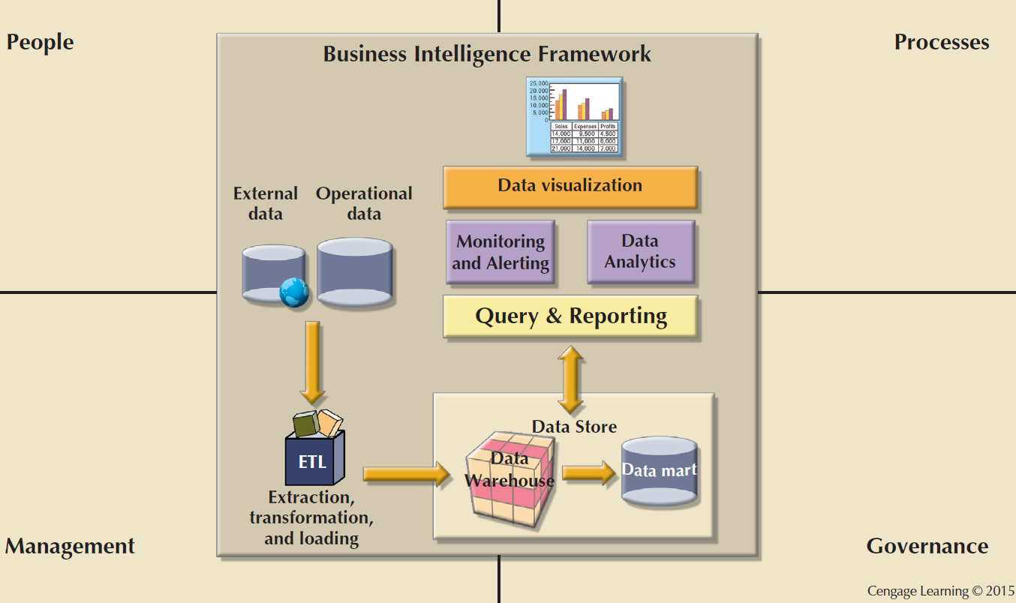
Figure 13.1 - Business Intelligence Framework

Slide 6
Business Intelligence Tools
Dashboards and business activity monitoring
  Dashboards: Shows key business performance indicators in a single integrated view
Portals: Integrate data using web browser from multiple sources into a single webpage
Data analysis and reporting tools
Data-mining tools
Data warehouses (DW)
OLAP tools and data visualization

Slide 7
Practices to Manage Data
Master data management (MDM): Collection of concepts, techniques, and processes for identification, definition, and management of data elements
Governance: Method of government for controlling business health and for consistent decision making
Key performance indicators (KPI): Numeric or scale-based measurements that assess company’s effectiveness in reaching its goals

Slide 8
Practices to Manage Data
Data visualization: Abstracting data to provide information in a visual format
  Enhances the user’s ability to efficiently comprehend the meaning of the data
  Techniques
    Pie charts and bar charts
    Line graphs
    Scatter plots
    Gantt charts
    Heat maps

Slide 9
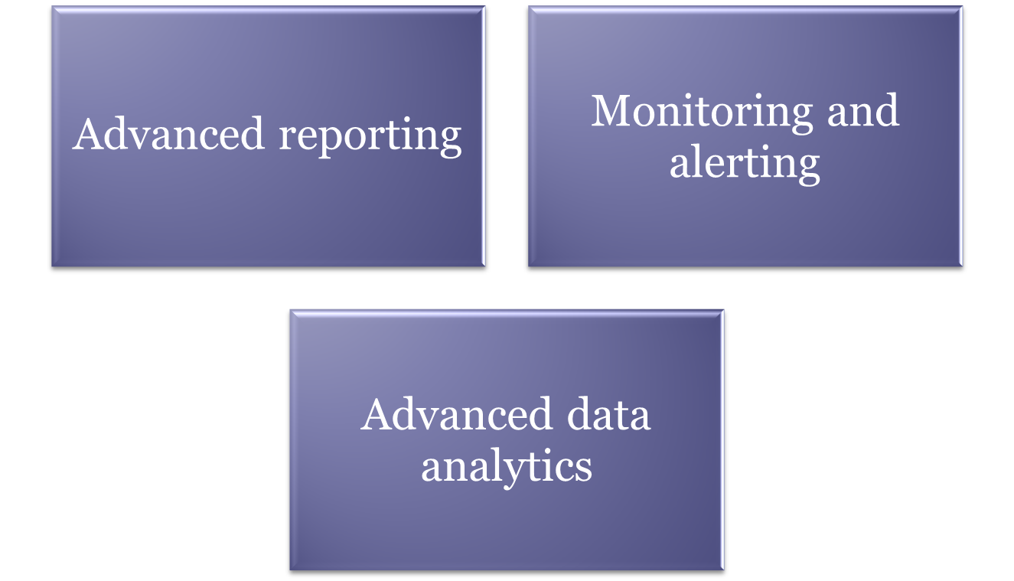
Reporting Styles of a Modern BI System

Slide 10
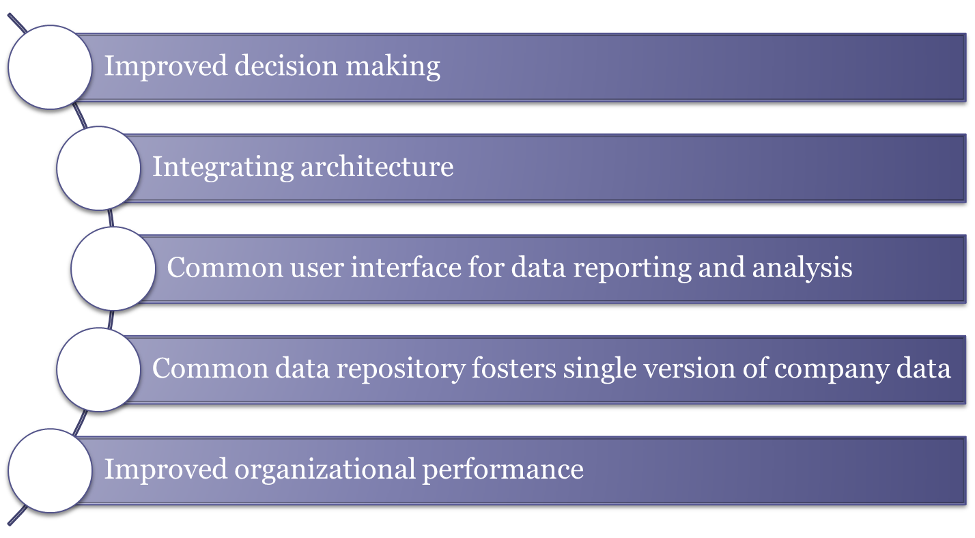
Business Intelligence Benefits

Slide 11
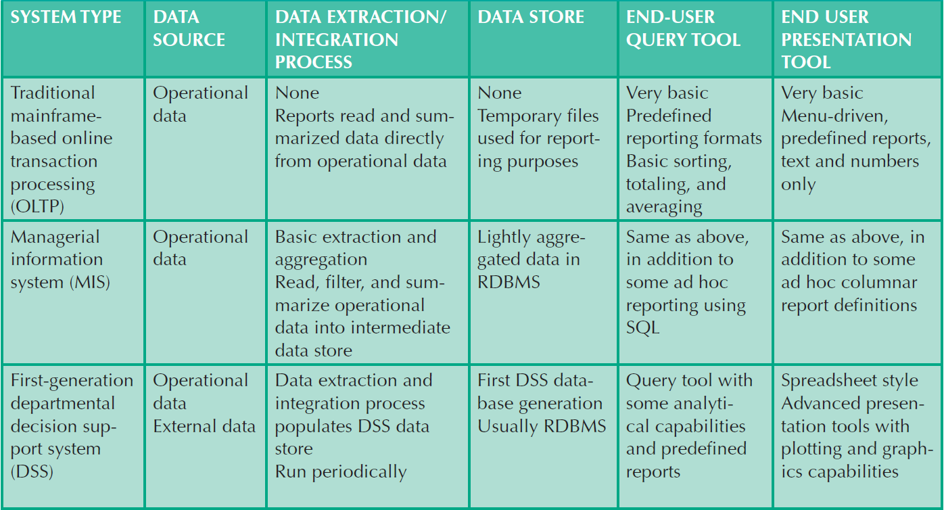
Table 13.4 - Business Intelligence Evolution
Cengage Learning © 2015

Slide 12
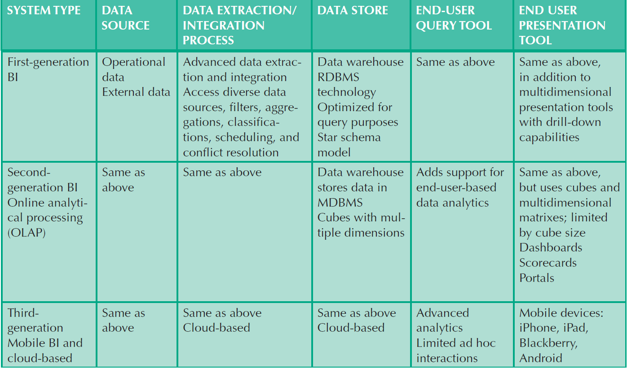
Table 13.4 - Business Intelligence Evolution
Cengage Learning © 2015

Slide 13
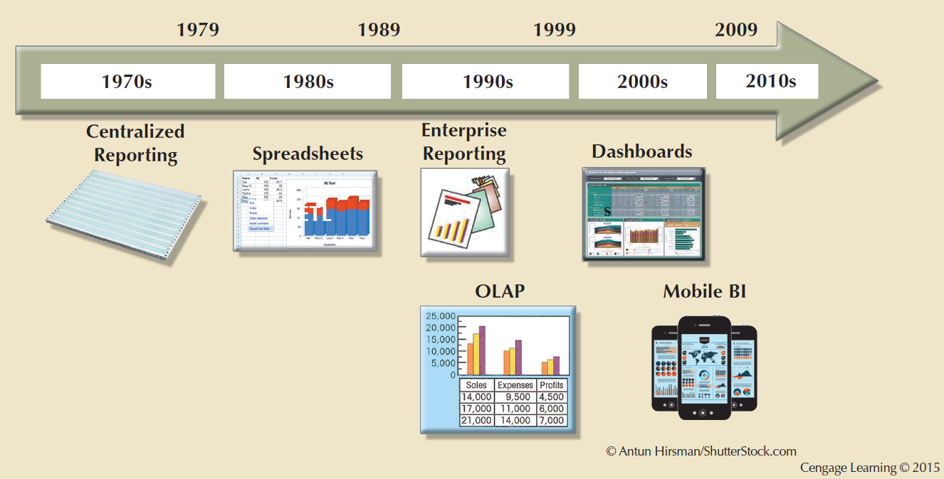
Figure 13.3 - Evolution of BI Information Dissemination Formats

Slide 14
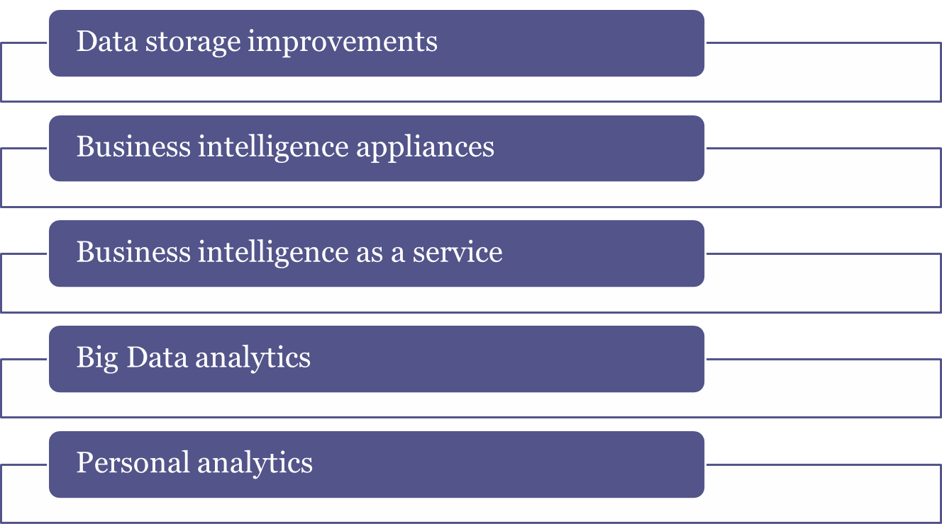
Business Intelligence Technology Trends

Slide 15
Decision Support Data
Effectiveness of BI depends on quality of data gathered at operational level
Operational data
  Seldom well-suited for decision support tasks
  Stored in relational database with highly normalized structures
  Optimized to support transactions representing daily operations

Slide 16
Decision Support Data
Differ from operational data in:
  Time span
  Granularity
    Drill down: Decomposing a data to a lower level
    Roll up: Aggregating a data into a higher level
  Dimensionality

Slide 17
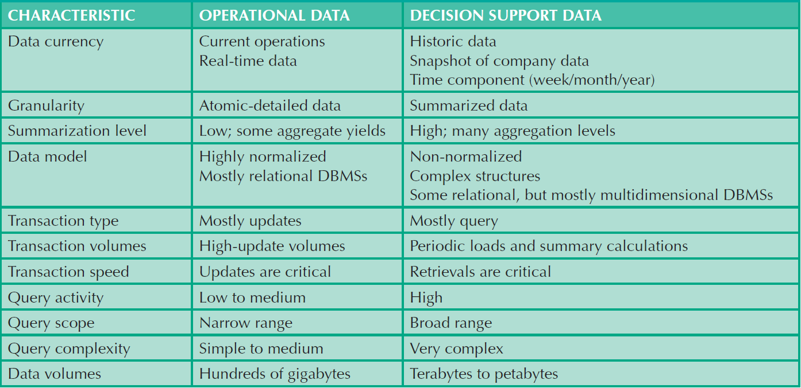
Table 13.5 - Contrasting Operational and Decision Support Data Characteristics
Cengage Learning © 2015

Slide 18
Decision Support Database Requirements
Database schema
  Must support complex, non-normalized data representations
  Data must be aggregated and summarized
  Queries must be able to extract multidimensional time slices

Slide 19
Decision Support Database Requirements
Data extraction and loading
  Allow batch and scheduled data extraction
  Support different data sources and check for inconsistent data or data validation rules
  Support advanced integration, aggregation, and classification
Database size should support:
  Very large databases (VLDBs)
  Advanced storage technologies
  Multiple-processor technologies

Slide 20
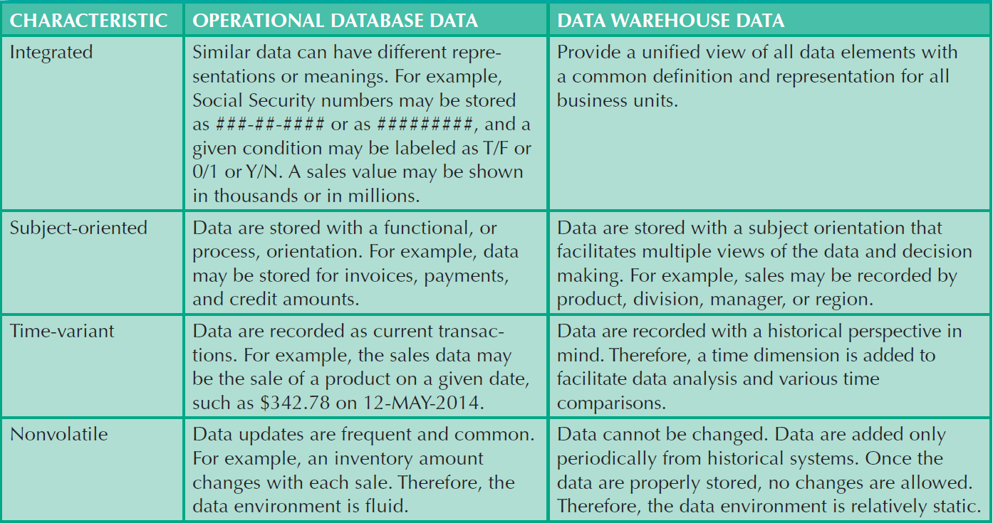
Table 13.8 - Characteristics of Data Warehouse Data and Operational Database Data
Cengage Learning © 2015

Slide 21
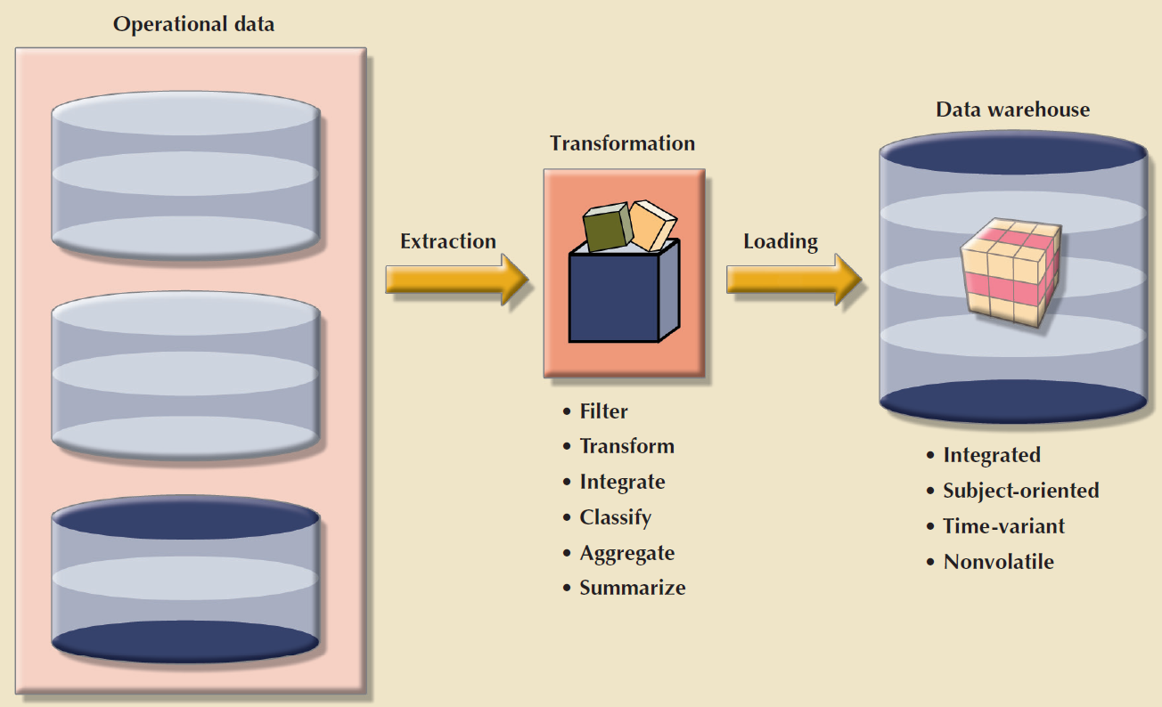
Figure 13.5 - The ETL Process
Cengage Learning © 2015

Slide 22
Data Marts
Small, single-subject data warehouse subset
Provide decision support to a small group of people
Benefits over data warehouses
  Lower cost and shorter implementation time
  Technologically advanced
  Inevitable people issues

Slide 23
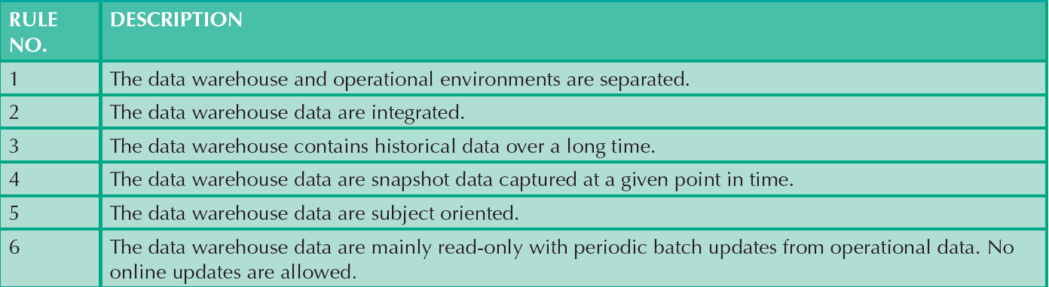
Table 13.9 - Twelve Rules for a Data Warehouse
Cengage Learning © 2015

Slide 24
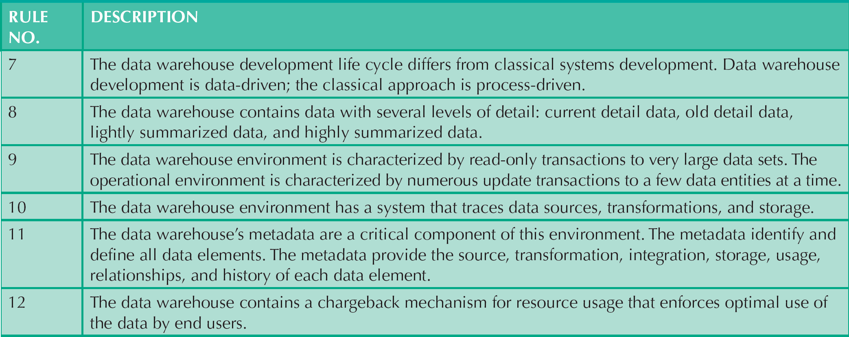
Table 13.9 - Twelve Rules for a Data Warehouse
Cengage Learning © 2015

Slide 25
Star Schema
Data-modeling technique
Maps multidimensional decision support data into a relational database
Creates the near equivalent of multidimensional database schema from existing relational database
Yields an easily implemented model for multidimensional data analysis

Slide 26
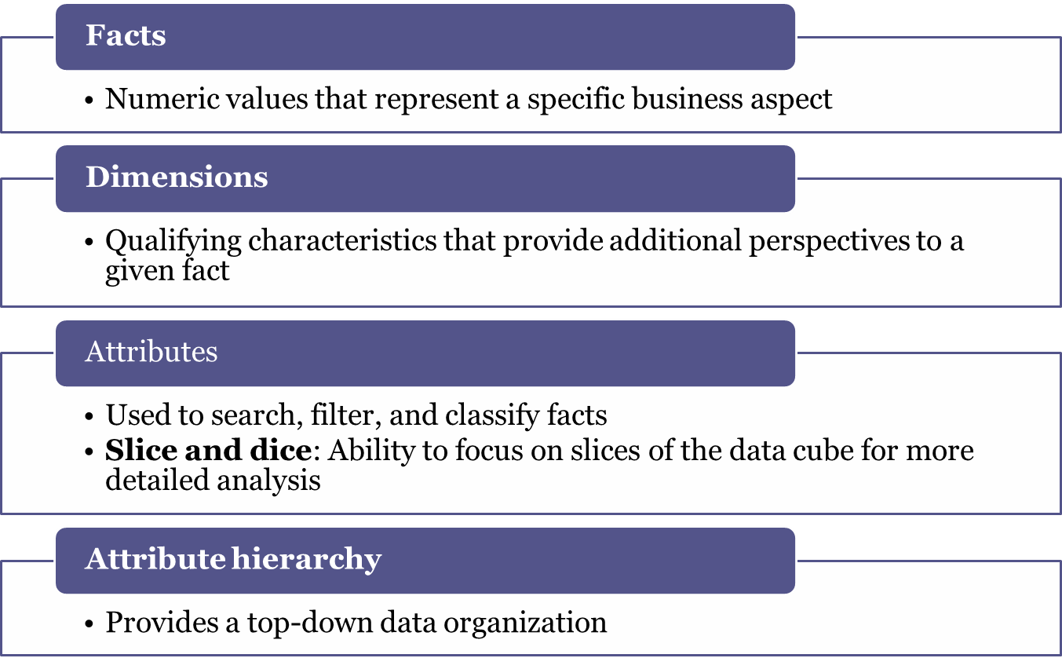
Components of Star Schemas

Slide 27
Star Schema Representation
Facts and dimensions represented by physical tables in data warehouse database
Many-to-one (M:1) relationship between fact table and each dimension table
Fact and dimension tables
  Related by foreign keys
  Subject to primary and foreign key constraints

Slide 28
Star Schema Representation
  Primary key of a fact table
    Is a composite primary key because the fact table is related to many dimension tables
    Always formed by combining the foreign keys pointing to the related dimension tables

Slide 29
Techniques Used to Optimize Data Warehouse Design
Normalizing dimensional tables
  Snowflake schema: Dimension tables can have their own dimension tables
Maintaining multiple fact tables to represent different aggregation levels
Denormalizing fact tables

Slide 30
Techniques Used to Optimize Data Warehouse Design
Partitioning and replicating tables
  Partitioning: Splits tables into subsets of rows or columns and places them close to customer location
  Replication: Makes copy of table and places it in a different location
  Periodicity: Provides information about the time span of the data stored in the table

Slide 31
Data Analytics
Encompasses a wide range of mathematical, statistical, and modeling techniques to extract knowledge from data
  Subset of BI functionality
Classification of tools
  Explanatory analytics: Focuses on discovering and explaining data characteristics and relationships based on existing data
  Predictive analytics: Focuses on predicting future outcomes with a high degree of accuracy

Slide 32
Data Mining
Analyzing massive amounts of data to:
  Uncover hidden trends, patterns, and relationships
  Form computer models to stimulate and explain the findings
  Use the models to support business decision making
Run in two modes
  Guided
  Automated

Slide 33
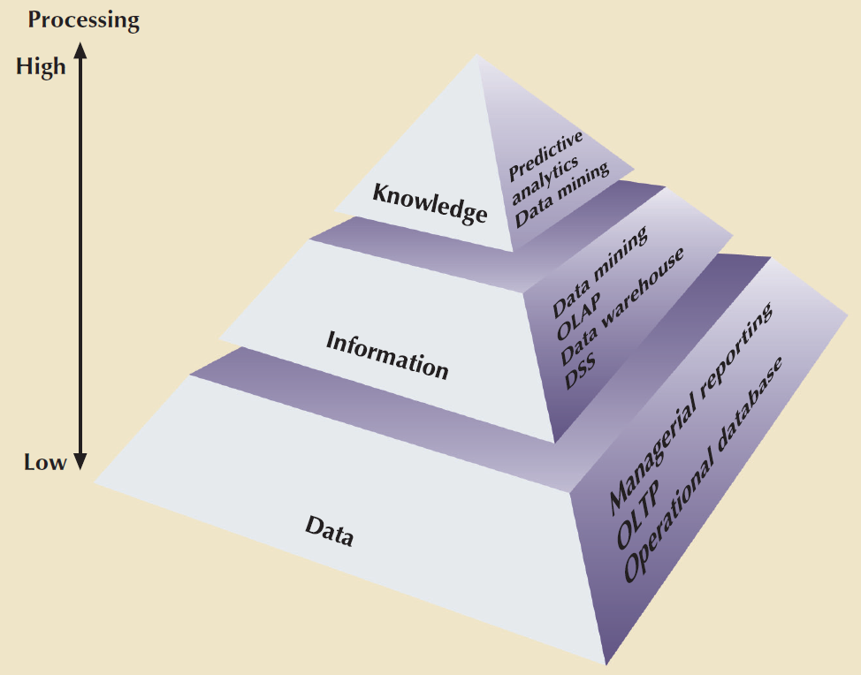
Figure 13. 15 - Extracting Knowledge from Data
Cengage Learning © 2015

Slide 34
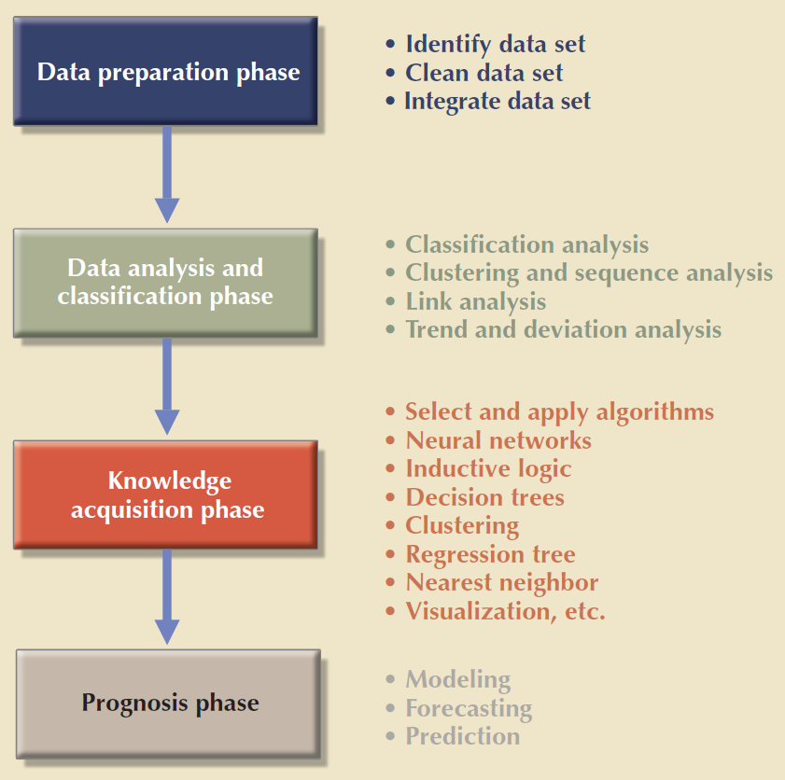
Figure 13. 16 - Data-Mining Phases
Cengage Learning © 2015

Slide 35
Predictive Analytics
Employs mathematical and statistical algorithms, neural networks, artificial intelligence, and other advanced modeling tools
Creates actionable predictive models based on available data
  Next logical step after data mining
Adds value to an organization
  Helps optimize the existing processes
  Identify hidden problems
  Anticipate future problems or opportunities

Slide 36
Online Analytical Processing
Advanced data analysis environment that supports decision making, business modeling, and operations research
Characteristics
  Multidimensional data analysis techniques
  Advanced database support
  Easy-to-use end-user interfaces

Slide 37
Multidimensional Data Analysis Techniques
Data are processed and viewed as part of a multidimensional structure
Augmenting functions
  Advanced data presentation functions
  Advanced data aggregation, consolidation, and classification functions
  Advanced computational functions
  Advanced data-modeling functions

Slide 38
Advanced Database Support
Advanced data access features
  Access to many different kinds of DBMSs, flat files, and internal and external data sources
  Access to aggregated data warehouse data and to the detail data found in operational databases
  Advanced data navigation features
  Rapid and consistent query response times
  Ability to map end-user requests to appropriate data source and to proper data access language
  Support for very large databases

Slide 39
Easy-to-Use End-User Interface
Proper implementation leads to simple navigation and accelerated decision making or data analysis
Advanced OLAP features are more useful when access is kept simple
Many interface features are borrowed from previous generations of data analysis tools

Slide 40
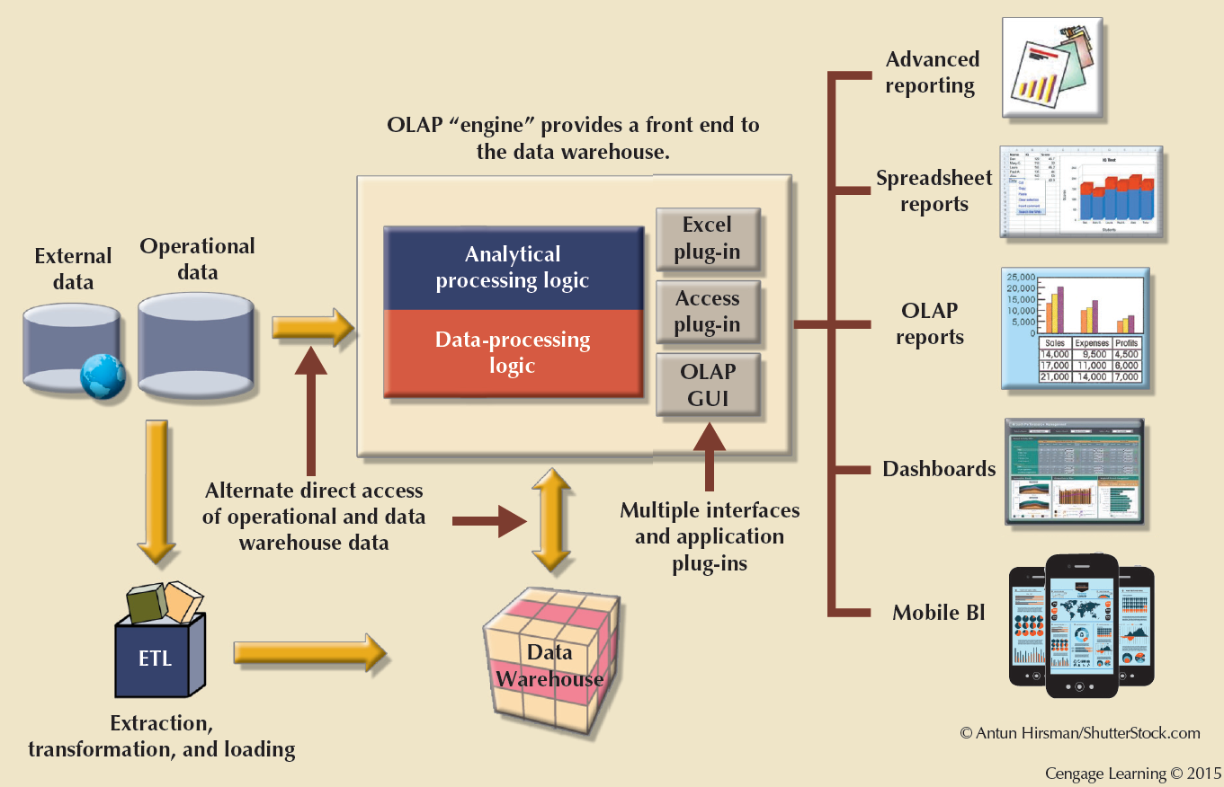
Figure 13.19 - OLAP Architecture

Slide 41
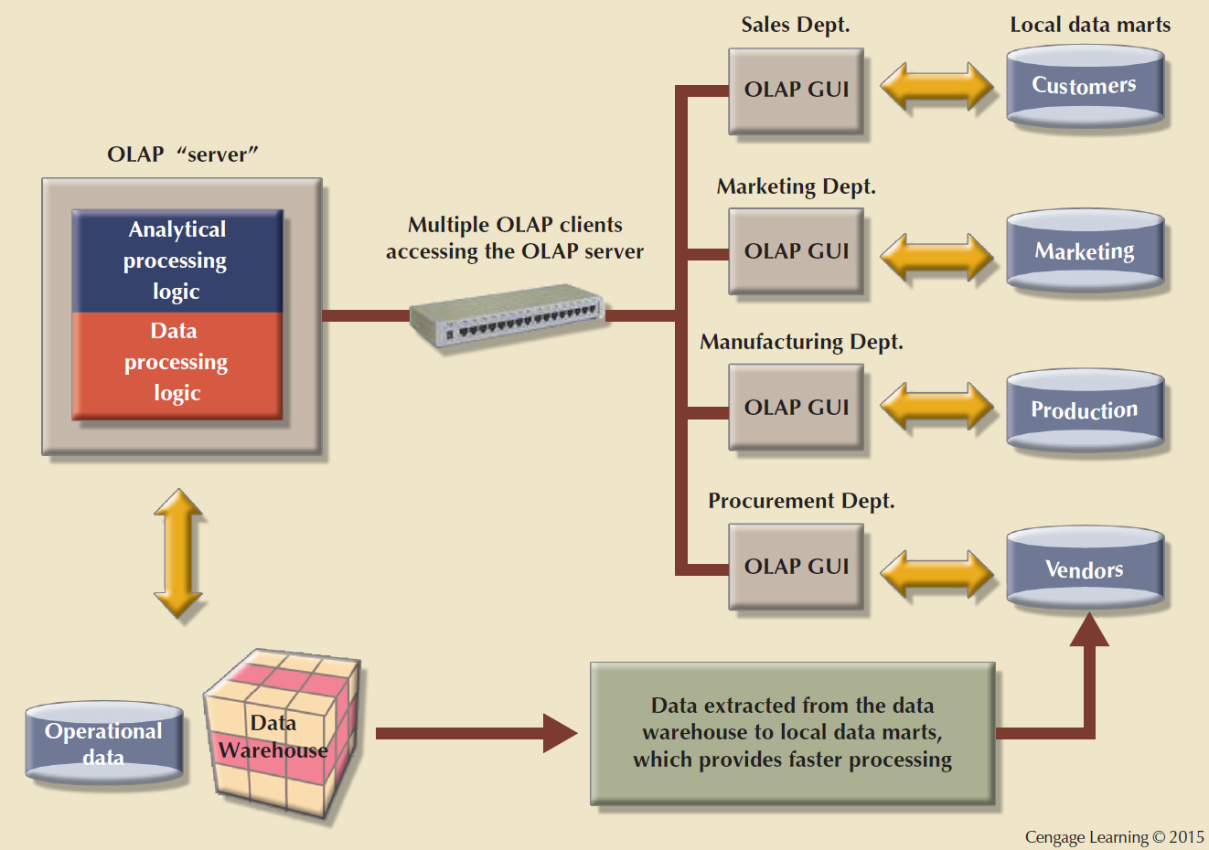
Figure 13.20 - OLAP Server with Local Miniature Data Marts

Slide 42
Relational Online Analytical Processing (ROLAP)
Provides OLAP functionality using relational databases and familiar relational tools to store and analyze multidimensional data
Extensions added to traditional RDBMS technology
  Multidimensional data schema support within the RDBMS
  Data access language and query performance optimized for multidimensional data
  Support for very large databases (VLDBs)

Slide 43
Multidimensional Online Analytical Processing (MOLAP)
Extends OLAP functionality to multidimensional database management systems (MDBMSs)
  MDBMS: Uses proprietary techniques store data in matrix-like n-dimensional arrays
  End users visualize stored data as a 3D data cube
    Grow to n dimensions, becoming hypercubes
    Held in memory in a cube cache to speed access
Sparsity: Measures the density of the data held in the data cube

Slide 44
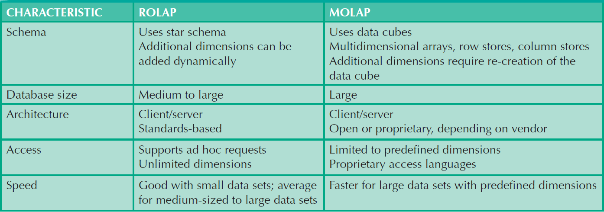
Table 13.12 - Relational vs. Multidimensional OLAP
Cengage Learning © 2015

Slide 45
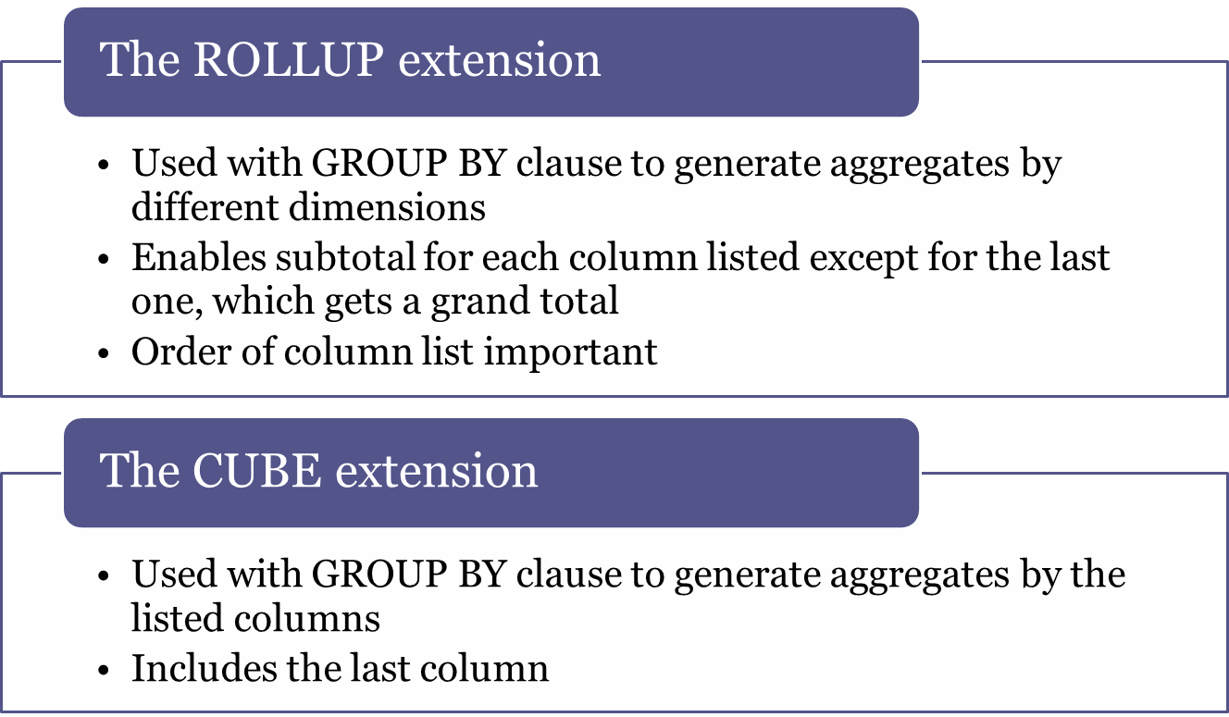
SQL Extensions for OLAP

Slide 46
Materialized View
Dynamic table that contains SQL query command to generate rows and stores the actual rows
Created the first time query is run
  Summary rows are stored in the table
Automatically updated when base tables are updated
Requires specified privileges

